Slide 1
INTRODUCTION
Exploratory Data Analysis (EDA)
Explores and summarizes data using statistics and visuals to detect patterns, trends, and anomalies. Techniques: Handling missing values, correlation analysis, distribution checks
Data Visualization
Presents data through charts and graphs to highlight trends and make insights easy to understand. Tools: Matplotlib, Seaborn, Plotly, Tableau

Slide 2
BASIC OF EDA
1.df.head()
It shows the first five rows of dataset and also provides no of rows based on your requirements.
2.df.tail()
It gives last five rows of data
3.df.shape()
Gives the number of rows and columns
4.df.info()
Provides data types, non-null counts, and memory usage.

Slide 3
BASIC OF EDA
5. df.describe()
Shows summary statistics for numerical columns.
6. df.columns
Lists all the column names.
7. df.dtypes
Shows the data type of each column.
8. df.isnull().sum()
Checks how many missing values are in each column.
9. df.nunique()
Shows the number of unique values in each column.

Slide 4
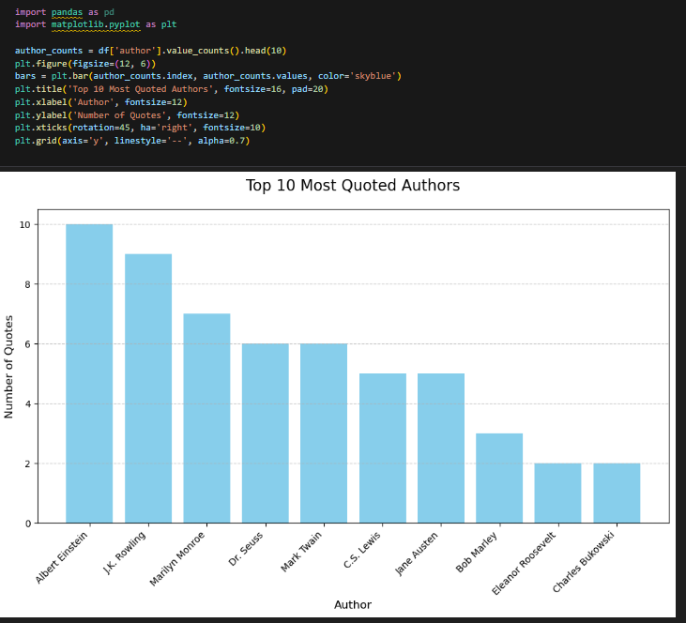
Bar chart of the top 10 most quoted authors.
Data Visualization
The chart is a vertical bar chart where each sky-blue bar represents an author, with height indicating the number of quotes.
The data is derived from the top 10 authors based on quote frequency using the function value_counts().

Slide 5
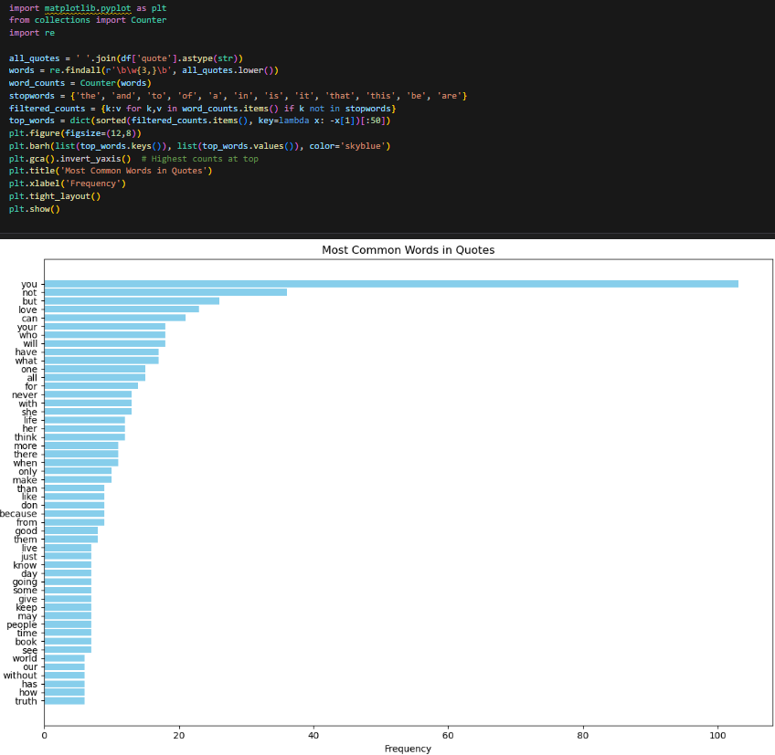
Data Visualization
Word cloud of the most common words in the quotes
This horizontal bar chart illustrates the top 50 most frequently occurring words in a collection of quotes, excluding common stopwords like "the", "and", "is", etc.
The most frequent word is "you", followed by "not" and "but", highlighting the personal and emotive language often used in quotes. reduce little bit
The chart uses a sky blue color scheme for visual clarity and inverts the y-axis to show the highest frequency words at the top.

Slide 6
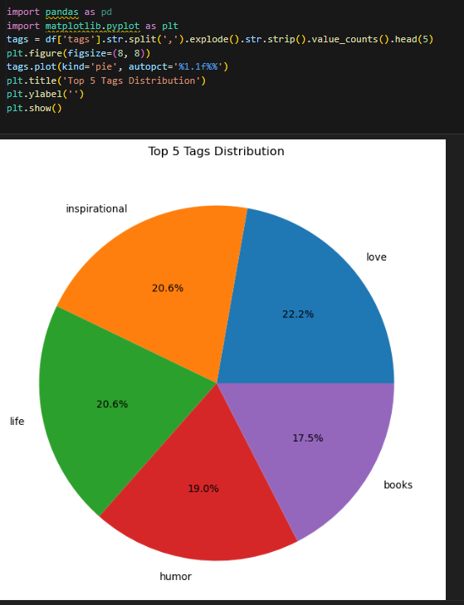
Data Visualization
Pie chart showing the proportion of top 5 tags.
This pie chart visualizes the top 5 most common tags found in the dataset. The chart clearly shows that "love" is the most popular tag, making up 22.2% of the top five, followed closely by "inspirational" and "life", each accounting for 20.6%. "Humor" and "books" follow, with 19.0% and 17.5% respectively, highlighting the emotional and literary focus of the content. The pie chart uses vivid colors and percentage labels to enhance interpretability.

Slide 7
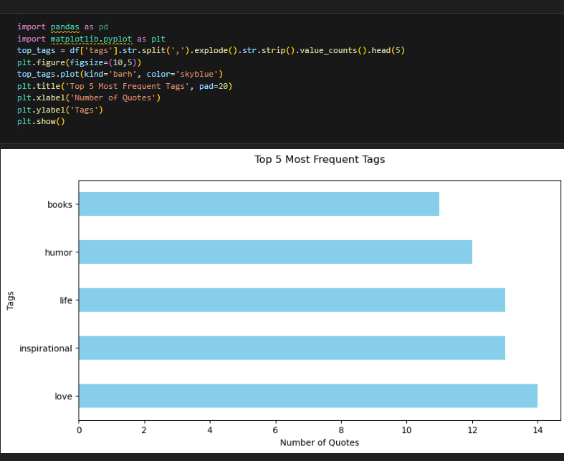
Data Visualization
The Top 5 Most Common Tags using a bar chart
This horizontal bar chart displays the Top 5 Most Frequent Tags found in the quotes dataset. Each bar represents the number of quotes associated with a specific tag, with "love", "inspirational", and "life" being the most prominent. The use of a sky-blue color and horizontal layout enhances readability and clearly highlights the popularity of different themes in the data

